Slide 1



Noida Institute of Engineering and Technology, Greater Noida
Linear Regression Bayesian Learning
and
Support Vector Machines
Unit: 2
Subject Name:
Machine Learning Techniques
(ACSML0401 )
Faculty details:
Alisha Sikri
Assistant Professor
AIML
B Tech 4th Sem

Slide 2


Faculty Profile
Noida Institute of Engineering and Technology, Greater Noida
Name: Alisha Sikri
Qualification: PhD (Pursuing)
Specialization Areas: Machine Learning, Artificial Intelligence
COURSE | BOARD/UNIVERSITY | YEAR OF PASSING
PhD | SRM University, NCR | Pursuing
M.Tech | DCRUST University, Murthal | 2016
B.Tech | MDU, Rohtak | 2014

Slide 3
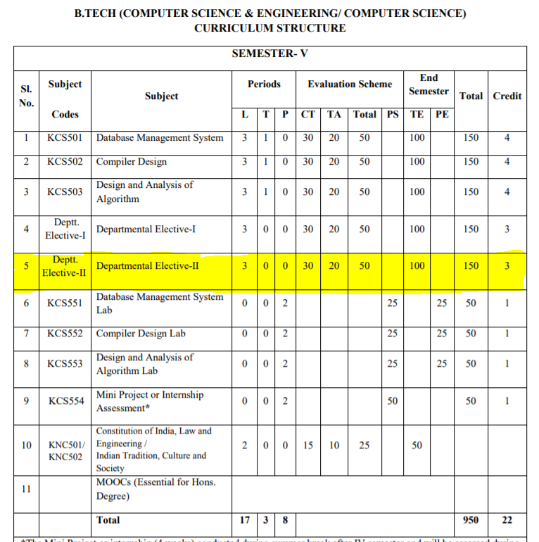
Evaluation Scheme

Slide 4
Syllabus
Unit-I : Introduction-
Learning, Types of Learning, Well defined learning problems, Designing a Learning System, History of ML, Introduction of Machine Learning Approaches – (Artificial Neural Network, Clustering, Reinforcement Learning, Decision Tree Learning, Bayesian networks, Support Vector Machine, Genetic Algorithm), Issues in Machine Learning and Data Science Vs Machine Learning
Unit-II : REGRESSION:
Linear Regression and Logistic Regression BAYESIAN LEARNING - Bayes theorem, Concept learning, Bayes Optimal Classifier, Naïve Bayes classifier, Bayesian belief networks, EM algorithm. SUPPORT VECTOR MACHINE: Introduction, Types of support vector kernel – (Linear kernel, polynomial kernel,and Gaussiankernel), Hyperplane – (Decision surface), Properties of SVM, and Issues in SVM.
Unit-III : DECISION TREE LEARNING - Decision tree learning algorithm, Inductive bias, Inductive inference with decision trees, Entropy and information theory, Information gain, ID-3 Algorithm, Issues in Decision tree learning. INSTANCE-BASED LEARNING – k-Nearest Neighbour Learning, Locally Weighted Regression, Radial basis function networks, Case-based learning.

Slide 5
Syllabus
Unit-IV : ARTIFICIAL NEURAL NETWORKS –
Perceptron’s, Multilayer perceptron, Gradient descent and the Delta rule, Multilayer networks, Derivation of Backpropagation Algorithm, Generalization, Unsupervised Learning – SOM Algorithm and its variant; DEEP LEARNING - Introduction, concept of convolutional neural network , Types of layers – (Convolutional Layers , Activation function , pooling , fully connected) , Concept of Convolution (1D and 2D) layers, Training of network, Case study of CNN for eg on Diabetic Retinopathy, Building a smart speaker, Self-deriving car etc..
Unit-V : REINFORCEMENT LEARNING–Introduction to Reinforcement Learning , Learning Task,Example of Reinforcement Learning in Practice, Learning Models for Reinforcement – (Markov Decision process , Q Learning - Q Learning function, Q Learning Algorithm ), Application of Reinforcement Learning,Introduction to Deep Q Learning. GENETIC ALGORITHMS: Introduction, Components, GA cycle of reproduction, Crossover, Mutation, Genetic Programming, Models of Evolution and Learning, Applications

Slide 6
Branch wise Application
Virtual Personal Assistants
Predictions while Commuting
Videos Surveillance
Social Media Services
Email Spam and Malware Filtering
Online Customer Support
Search Engine Result Refining
Product Recommendations
Online Fraud Detection

Slide 7
Course Objectives
This course will serve as a comprehensive introduction to various topics in machine learning
To introduce students to the basic concepts and techniques of Machine Learning.
To become familiar with regression methods, classification methods, clustering methods.
To introduce the concept of Decision Tree Learning and Instance-based Learning
To become familiar with Artificial Neural Networks and Deep Learning
To introduce the concept of Reinforcement Learning and Genetic Algorithms

Slide 8
Course Outcomes
At the end of the course, the student should be able to
COURSE OUTCOME NO | COURSE OUTCOMES
CO1 | To understand the need for machine learning for various problem solving
CO2 | To understand a wide variety of learning algorithms and how to evaluate models generated from data
CO3 | To understand the latest trends in machine learning
CO4 | To design appropriate machine learning algorithms and apply the algorithms to a real-world problems
CO5 | To optimize the models learned and report on the expected accuracy that can be achieved by applying the models

Slide 9
Course Outcomes
1. Engineering knowledge
2. Problem analysis
3. Design/development of solutions
4. Conduct investigations of complex problems
5. Modern tool usage
6. The engineer and society
7. Environment and sustainability
8. Ethics
9. Individual and team work
10. Communication
11. Project management and finance
12. Life-long learning

Slide 10
CO-PO Mapping
CO MAPPING WITH PO
CO. No. | PO1 | PO2 | PO 3 | PO 4 | PO 5 | PO 6 | PO 7 | PO 8 | PO 9 | PO 10 | PO 11 | PO 12
1 | 3 | 3 | 3 | 1 |  |  |  |  | 1 |  |  | 2
2 | 3 | 3 | 3 | 1 |  |  |  |  | 1 |  |  | 1
3 | 3 | 3 | 3 | 1 |  | 1 |  |  | 1 |  |  | 1
4 | 3 | 3 | 3 | 1 |  |  |  |  | 1 |  |  | 2
5 | 3 | 3 | 3 | 2

Slide 11
Program Specific Outcome (PSO)
On successful completion of graduation degree, The computer Science & Engineering graduates will be able to:
PSO1: identify, analyze real world problems and design their ethical solutions using artificial intelligence, robotics, virtual/augmented reality, data analytics, block chain technology, and cloud computing.
PSO2: design and develop the hardware sensor devices and related interfacing software systems for solving complex engineering problems.
PSO 3: understand inter-disciplinary computing techniques and to apply them in the design of advanced computing.
PSO 4: conduct investigation of complex problem with the help of technical, managerial, leadership qualities, and modern engineering tools provided by industry sponsored laboratories.

Slide 12
CO-PSO Mapping
CO MAPPING WITH PSO
CO/PSO | POS1 | POS2 | POS3 | POS4
CO 1 | 3 | 1 | 1 | -
CO 2 | 3 | 2 | - | -
CO 3 | 3 | 2 | - | -
CO 4 | 3 | 2 | 2 | 1
CO 5 | 3 | 2 | 1 | -

Slide 13
PEOs
PEO 1: To have an excellent scientific and engineering breadth so as to comprehend, analyze, design and provide sustainable solutions for real-life problems using state-of-the-art technologies.
PEO 2: To have a successful career in industries, to pursue higher studies or to support entrepreneurial endeavors and to face the global challenges.
PEO 3:To have an effective communication skills, professional attitude, ethical values and a desire to learn specific knowledge in emerging trends, technologies for research, innovation and product development and contribution to society.
PEO 4: To have life-long learning for up-skilling and re-skilling for successful professional career as engineer, scientist, entrepreneur and bureaucrat for betterment of society.

Slide 14
CO-PSO Mapping
CO. NO. | PSO1 | PSO2 | PSO3 | PSO4
1 | 1 | 2
2 | 1 | 2 | 1 | 1
3 | 2 | 1 | 1 | 2
4 | 1 | 1 | 1 | 2
5 | 1 | 1 | 1

Slide 15
Result Analysis
MLT(KCS-055)
Subject wise result | 95.62
Faculty wise result | 92.65

Slide 16
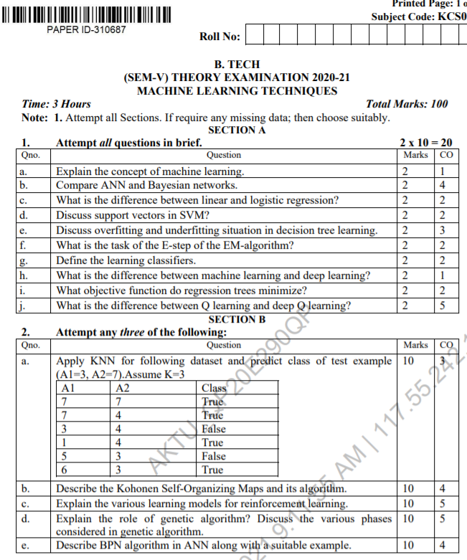
End Sem Question Papers Format

Slide 17
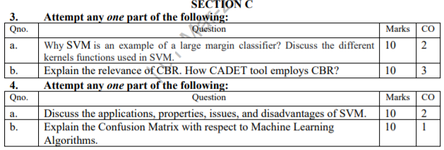
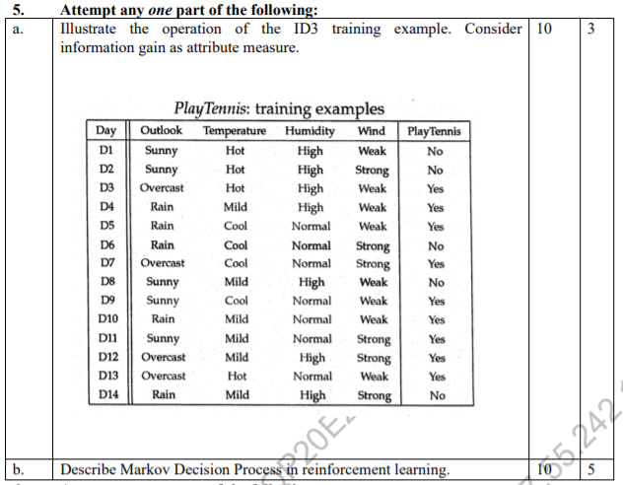
End Sem Question Papers Format

Slide 18
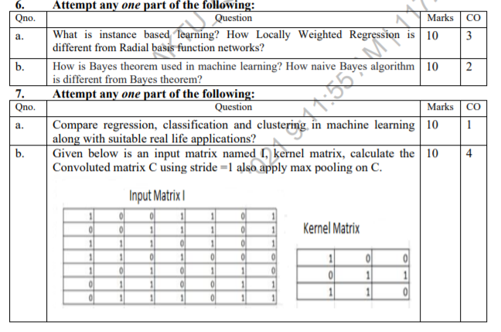
End Sem Question Papers Format

Slide 19
Prerequisite
To get started with Machine Learning you must be familiar with the following
concepts:
Algebra
variables, coefficients, and functions
linear equations such as y=b+w1x1+w2x2
logarithms, and logarithmic equations such as y=ln(1+ez)
sigmoid function
Linear algebra
tensor and tensor rank
matrix multiplication

Slide 20
Prerequisite
Trigonometry
Tan h (discussed as an activation function; no prior knowledge needed)
Calculus (optional, for advanced topics)
concept of a derivative (you won't have to actually calculate derivatives)
gradient or slope
partial derivatives (which are closely related to gradients)
chain rule (for a full understanding of the backpropagation algorithm for training neural networks)

Slide 21
Pre-requisite
Programming language:
It is essential to know programming languages like R and Python in order to implement the whole Machine Learning process. Python and R both provide in-built libraries that make it very easy to implement Machine Learning algorithms.

Slide 22
CONTENTS
Linear Regression
Simple Linear Regression
Multiple Linear Regression
Bayesian Learning
Bayes theorem
Concept learning
Bayes Optimal Classifier
Naïve Bayes classifier
Bayesian belief networks
EM algorithm

Slide 23
CONTENTS
SUPPORT VECTOR MACHINE
Introduction
Types of support vector kernel – (Linear kernel polynomial kernel, and Gaussian kernel)
Hyperplane – (Decision surface)
Properties of SVM
Issues in SVM

Slide 24
Objectives of Unit
Mainly the Unit’s objectives are:
To learn and understand Experimental Evaluation of Learning Algorithms by Measuring the accuracy of learned hypotheses.
To learn Probability theory and Bayes rule by Conceptualizing Naive Bayes learning algorithm, Parameter smoothing, Generative vs. discriminative training, Logisitic regression.
To learn Bayesian Classification: Naive Bayes, Parameter Estimation (ML, MAP), Sequential Pattern Classification
To learn SVM

Slide 25
Unit Outcomes
At the end of this course the students should be able to design and implement machine learning solutions to classification, regression, problems.
Construct learning algorithms which involves linear regression with a comprehension of regularization, bias-variance and evidence approximation.
Able to solve the classification problem based on probability theory
Able to apply SVM.

Slide 26
Topic Mapping with CO
Evaluating Hypotheses (CO2)
Sample error, true error (CO2)
Confidence intervals for observed hypothesis error (CO2)
Estimators (CO2)
Binomial distribution, Normal distribution (CO2)
Central Limit Theorem (CO2)
Paired t tests (CO2)
Comparing learning methods (CO2)

Slide 27
Topic Mapping with CO
BAYESIAN LEARNING (CO2)
Bayes theorem (CO2)
Concept learning (CO2)
Bayes Optimal Classifier (CO2)
Naïve Bayes classifier (CO2)
Bayesian belief networks (CO2)
EM algorithm (CO2)

Slide 28
Recap
Regression Analysis is a process of prediction the relationship between the independent variable and dependent variable.
Linear, multiple linear, Polynomial, SVR, Random Forest are the common types of regressor that help is predicting the continuous value from the trained given outcomes.
Decision Tress is a supervised learning technique used for both classification and regression.
ID3 Algorithm
CART
K-NN Algorithm is used to find the distance between the two data points form the dataset.
Instance Based Learning vs Case based Learning

Slide 29
WHAT IS REGRESSION?
Regression is a supervised learning technique which helps in finding the correlation between variables and enables us to predict the continuous output variable based on the one or more predictor variables.
Regression analysis is a statistical method to model the relationship between a dependent (target) and independent (predictor) variables with one or more independent variables.
More specifically, Regression analysis helps us to understand how the value of the dependent variable is changing corresponding to an independent variable when other independent variables are held fixed.
It predicts continuous/real values such as temperature, age, salary, price, etc.

Slide 30
REGRESSION(CONT’D)
In Regression, we plot a graph between the variables which best fits the given datapoints, using this plot, the machine learning model can make predictions about the data.
In simple words, "Regression shows a line or curve that passes through all the datapoints on target-predictor graph in such a way that the vertical distance between the datapoints and the regression line is minimum.
Examples:
Prediction of rain using temperature and other factors
Determining Market trends
Prediction of road accidents due to rash driving

Slide 31
TERMINOLOGIES
Dependent Variable: The main factor in Regression analysis which we want to predict or understand is called the dependent variable. It is also called target variable.
Independent Variable: The factors which affect the dependent variables or which are used to predict the values of the dependent variables are called independent variable, also called as a predictor.
Outliers: Outlier is an observation which contains either very low value or very high value in comparison to other observed values. An outlier may hamper the result, so it should be avoided.
Multicollinearity: If the independent variables are highly correlated with each other than other variables, then such condition is called Multicollinearity. It should not be present in the dataset, because it creates problem while ranking the most affecting variable.
Underfitting and Overfitting: If our algorithm works well with the training dataset but not well with test dataset, then such problem is called Overfitting. And if our algorithm does not perform well even with training dataset, then such problem is called underfitting.

Slide 32
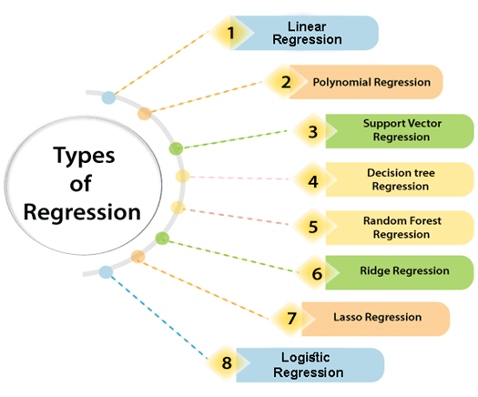
TYPES OF REGRESSION

Slide 33
TYPES OF REGRESSION(CONT’D)
1. LINEAR REGRESSION
Linear regression is a statistical regression method which is used for predictive analysis.
It is one of the very simple and easy algorithms which works on regression and shows the relationship between the continuous variables.
It is used for solving the regression problem in machine learning.
Linear regression shows the linear relationship between the independent variable (X-axis) and the dependent variable (Y-axis), hence called linear regression.
If there is only one input variable (x), then such linear regression is called simple linear regression. And if there is more than one input variable, then such linear regression is called multiple linear regression.
The relationship between variables in the linear regression model can be explained using the below image. Here we are predicting the salary of an employee on the basis of the year of experience.

Slide 34
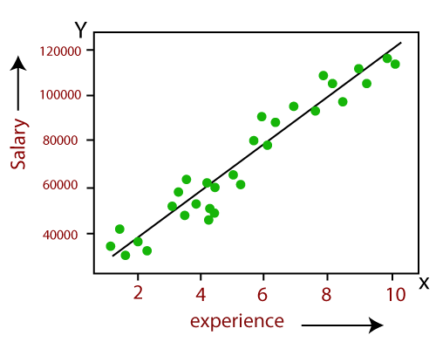
TYPES OF REGRESSION(CONT’D)
Below is the mathematical equation for Linear regression:
Y= mX+c
Here, Y = dependent variables (target variables), X=Independent variables (predictor variables), m= Slope and C= Intercept

Slide 35
TYPES OF REGRESSION(CONT’D)
2. MULTIPLE REGRESSION
Multiple regression generally explains the relationship between multiple independent or predictor variables and one dependent or criterion variable.
A dependent variable is modeled as a function of several independent variables with corresponding coefficients, along with the constant term.
Multiple regression requires two or more predictor variables, and this is why it is called multiple regression.
The multiple regression equation explained above takes the following form:
y = b₁x₁ + b₂x₂ + … + b_{n}x_{n} + c.
Here, b_{i}’s (i=1,2…n) are the regression coefficients, which represent the value at which the criterion variable changes when the predictor variable changes.

Slide 36
TYPES OF REGRESSION(CONT’D)
3. POLYNOMIAL REGRESSION
Polynomial Regression is a type of regression which models the non-linear dataset using a linear model.
It is similar to multiple linear regression, but it fits a non-linear curve between the value of x and corresponding conditional values of y.
Suppose there is a dataset which consists of datapoints which are present in a non-linear fashion, so for such case, linear regression will not best fit to those datapoints. To cover such datapoints, we need Polynomial regression.
In Polynomial regression, the original features are transformed into polynomial features of given degree and then modeled using a linear model. Which means the datapoints are best fitted using a polynomial line.

Slide 37
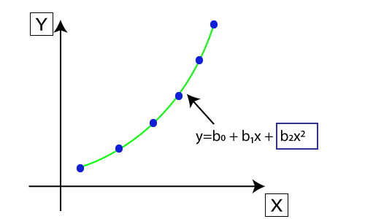
TYPES OF REGRESSION(CONT’D)
The equation for polynomial regression also derived from linear regression equation that means Linear regression equation Y= b₀+ b₁x, is transformed into Polynomial regression equation Y= b₀+b₁x+ b₂x²+ b₃x³+.....+ b_{n}x^{n}.
Here Y is the predicted/target output, b₀, b₁,... b_{n} are the regression coefficients. x is our independent/input variable.

Slide 38
TYPES OF REGRESSION(CONT’D)
4. SUPPORT VECTOR REGRESSION
Support Vector Machine is a supervised learning algorithm which can be used for regression as well as classification problem.
Support Vector Regression is a regression algorithm which works for continuous variables.
Kernel: It is a function used to map a lower-dimensional data into higher dimensional data.
Hyperplane: In general SVM, it is a separation line between two classes, but in SVR, it is a line which helps to predict the continuous variables and cover most of the datapoints.
Boundary line: Boundary lines are the two lines apart from hyperplane, which creates a margin for datapoints.
Support vectors: Support vectors are the datapoints which are nearest to the hyperplane and opposite class.

Slide 39
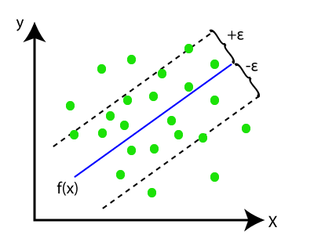
TYPES OF REGRESSION(CONT’D)
In SVR, we always try to determine a hyperplane with a maximum margin, so that maximum number of datapoints are covered in that margin. The main goal of SVR is to consider the maximum datapoints within the boundary lines and the hyperplane (best-fit line) must contain a maximum number of datapoints.
HYPERPLANE

Slide 40
TYPES OF REGRESSION(CONT’D)
5. RANDOM FOREST REGRESSION
Random Forest is a popular machine learning algorithm that belongs to the supervised learning technique.
It can be used for both Classification and Regression problems in ML.
It is based on the concept of ensemble learning, which is a process of combining multiple classifiers to solve a complex problem and to improve the performance of the model.
As the name suggests, "Random Forest is a classifier that contains a number of decision trees on various subsets of the given dataset and takes the average to improve the predictive accuracy of that dataset." Instead of relying on one decision tree, the random forest takes the prediction from each tree and based on the majority votes of predictions, and it predicts the final output.
The greater number of trees in the forest leads to higher accuracy and prevents the problem of overfitting

Slide 41
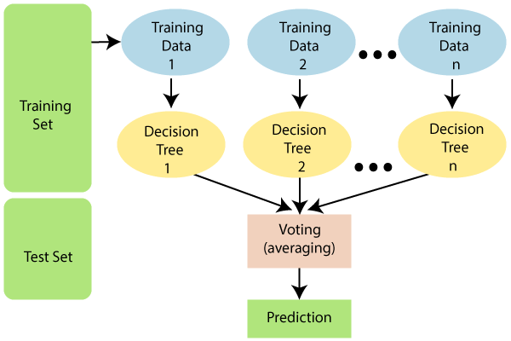
TYPES OF REGRESSION(CONT’D)
The below diagram explains the working of the Random Forest algorithm:

Slide 42
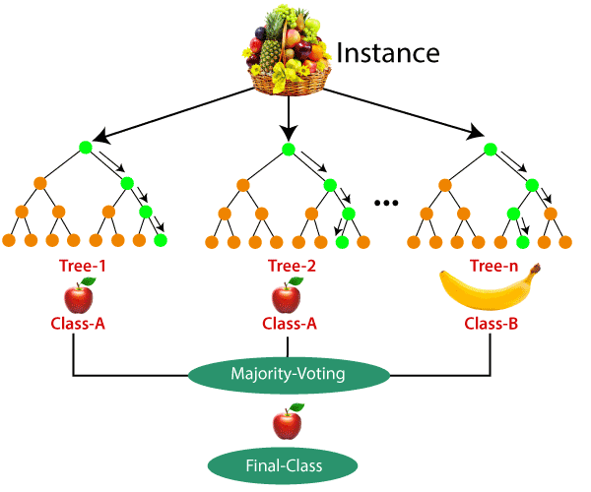
TYPES OF REGRESSION(CONT’D)
Example: Suppose there is a dataset that contains multiple fruit images. So, this dataset is given to the Random forest classifier. The dataset is divided into subsets and given to each decision tree. During the training phase, each decision tree produces a prediction result, and when a new data point occurs, then based on the majority of results, the Random Forest classifier predicts the final decision. Consider the below image:

Slide 43
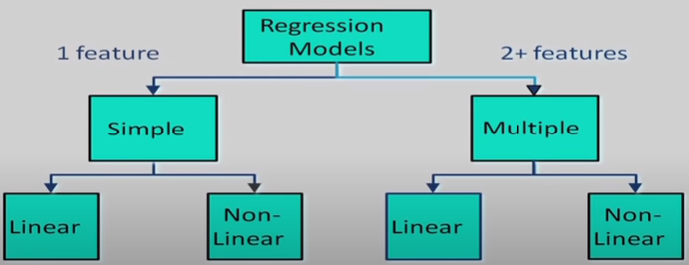
Regression

Slide 44

Linear Regression
Linear regression is a statistical regression method which is used for predictive analysis.
It is one of the very simple and easy algorithms which works on regression and shows the relationship between the continuous variables.
It is used for solving the regression problem in machine learning.
Linear regression shows the linear relationship between the independent variable (X-axis) and the dependent variable (Y-axis), hence called linear regression.
If there is only one input variable (x), then such linear regression is called simple linear regression. And if there is more than one input variable, then such linear regression is called multiple linear regression.
The relationship between variables in the linear regression model can be explained using the below image. Here we are predicting the salary of an employee on the basis of the year of experience.
3

Slide 45
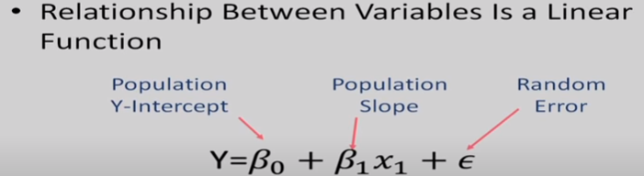
Linear Regression Model

Slide 46
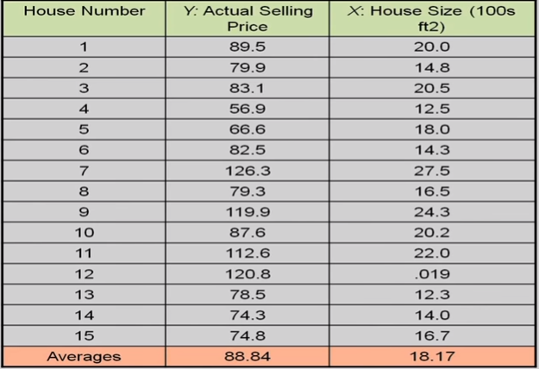

Linear Regression Model

Slide 47
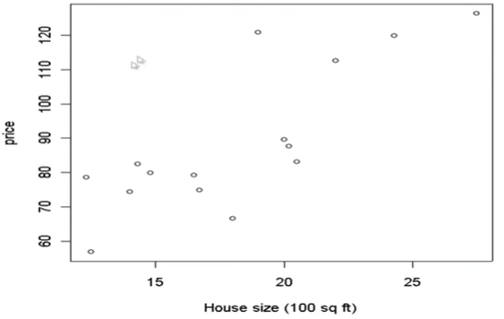
House price VS size

Slide 48
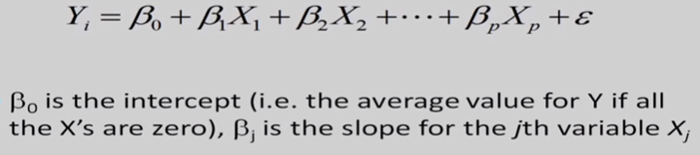
Linear Regression- Multiple Variables

Slide 49
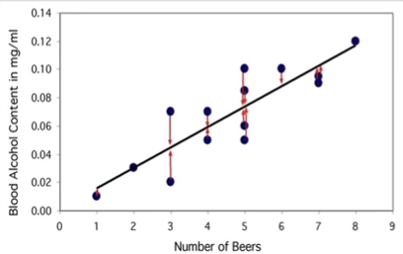
The Regression Line

Slide 50
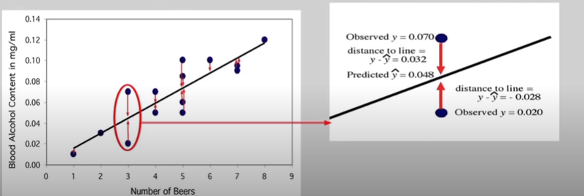
The Regression Line

Slide 51
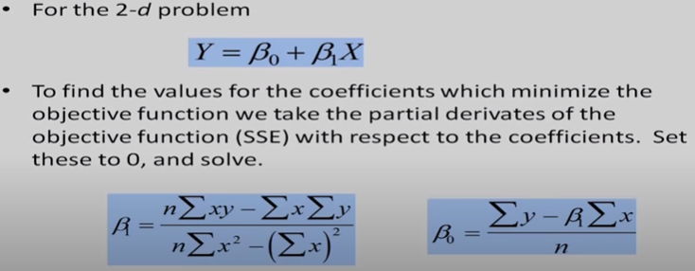
How do we learn parameters

Slide 52
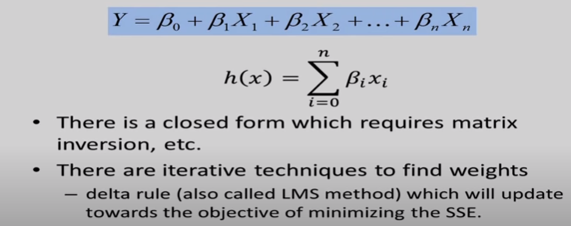
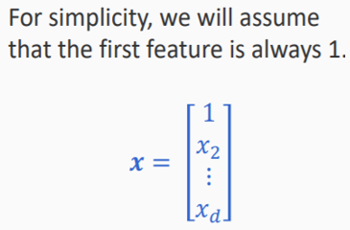
Multiple Linear Regression

Slide 53
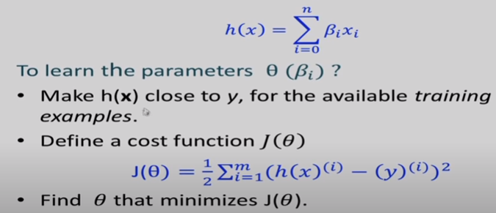
Multiple Linear Regression

Slide 54
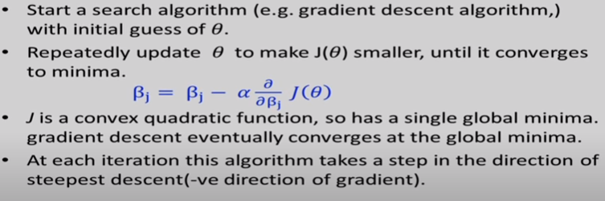
LMS Algorithm

Slide 55
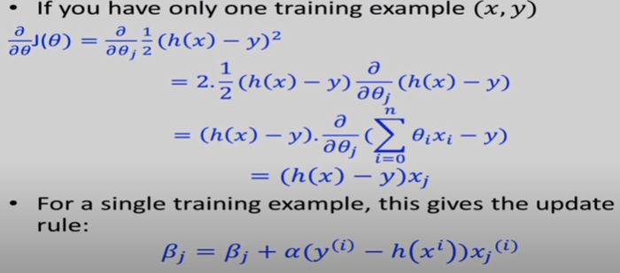
LMS Update Rule

Slide 56
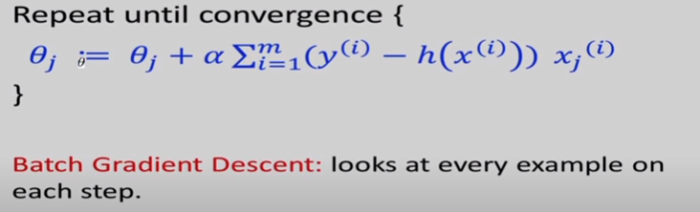
LMS Update Rule
M training examples

Slide 57
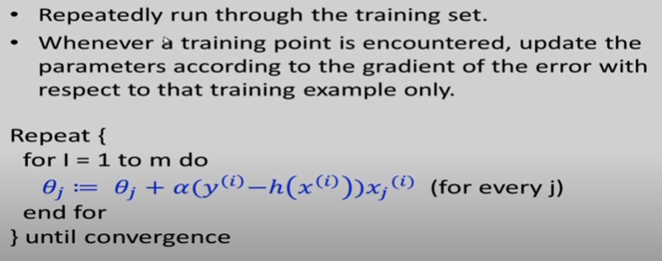
Stochastic Gradient descent

Slide 58
Linear regression: The strategy
Predicting continuous values using a linear model Assumption: The output is a linear function of the inputs
Mileage = β 0+ β1x1+ β2x2
Learning: Using the training data to find the best possible value
of β
Prediction: Given the values for x 1, x 2for a new car, use the learned βi to predict the Mileage for the new car
5

Slide 59


Linear regression: The strategy
Predicting continuous values using a linear model Assumption: The output is a linear function of the inputs
Mileage = β0+ β1x1+ β2x2
Parameters of the model Also called weights Collectively, a vector
Learning: Using the training data to find the best possible value of β
Prediction: Given the values for x1, x2 for a new car, use the learned β to predict the Mileagefor the new car
6

Slide 60
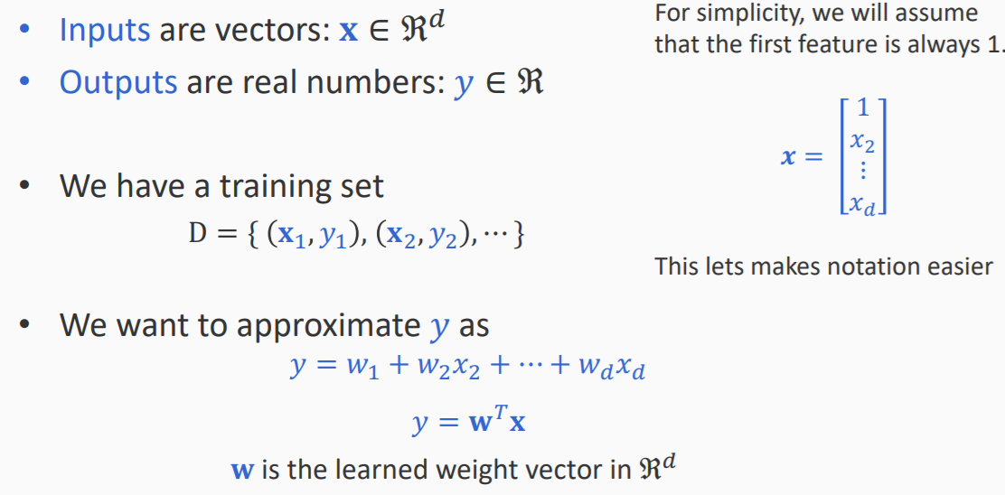
Linear regression: The strategy

Slide 61
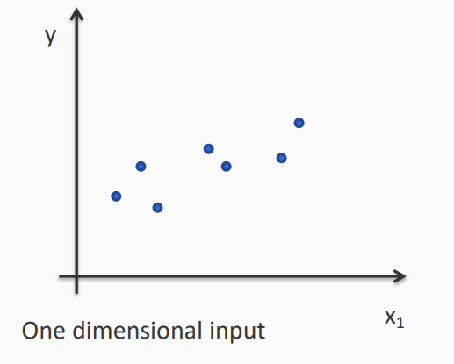
Example
8

Slide 62
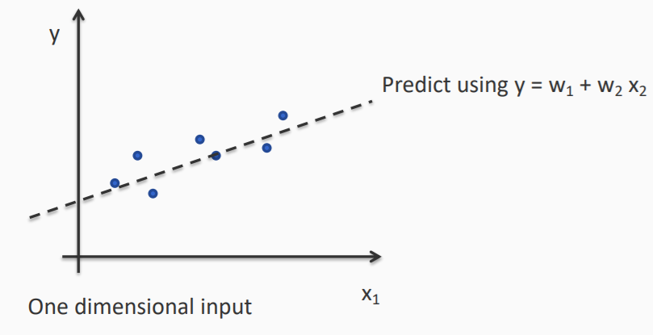
Example
8

Slide 63
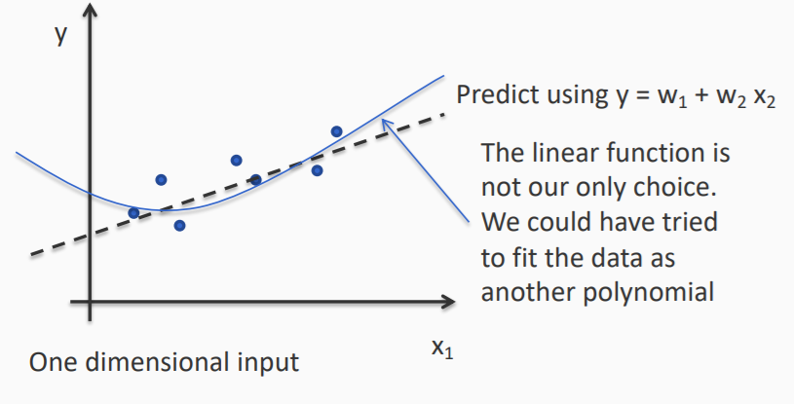
Example
8

Slide 64
What is the best weight vector?
How do we know which weight vector is the best one for a training set ?
8

Slide 65



What is the best weight vector?
How do we know which weight vector is the best one for a training set ?
For an input (xi, yi) in the training set, the cost of a mistake is
$$y_{i}−β_{i}x_{i}$$
$$J\left(w\right)=\frac{1}{2}\sum_{i=1}^{m}{{{(y}_{i}−β_{i}x_{i})}^{2}}$$
Define the cost (or loss) for a particular weight vector w to be
$$J\left(w\right)=\frac{1}{2}\sum_{i=1}^{m}{{{(y}_{i}−β_{i}x_{i})}^{2}}$$
Sum of squared costs over the training set
One strategy for learning: Find the $β$ with least cost on this data
8

Slide 66

Least Mean Squares (LMS) Regression
$$\frac{1}{2}\sum_{i=1}^{m}{{{(y}_{i}−β_{i}x_{i})}^{2}}$$
Learning: minimizing mean squared error
Different strategies exist for learning by optimization
• Gradient descent is a popular algorithm
(For this particular minimization objective, there is also an analytical solution. No need for gradient descent)
18

Slide 67

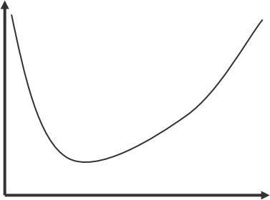


Gradient descent
We are trying to minimize
J(w)
General strategy for minimizing a function J(w)
• Start with an initial guess for w, say w0
• Iterate till convergence:
– Compute the gradient of the gradient of J at wt
– Update wtto get wt+1 by taking a step in the opposite direction of the gradient
w
Intuition: The gradient is the direction of steepest increase in the function. To get to the minimum, go in the opposite direction
21

Slide 68
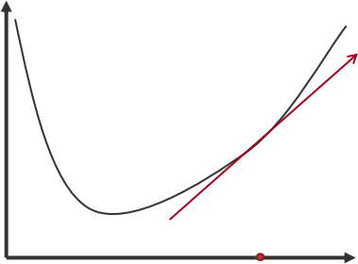
Gradient descent
We are trying to minimize
J(w)
General strategy for minimizing a function J(w)
• Start with an initial guess for w, say w0
• Iterate till convergence:
– Compute the gradient of the gradient of J at wt
– Update wtto get wt+1 by taking a step in the opposite direction of the gradient
w
w0
Intuition: The gradient is the direction of steepest increase in the function. To get to the minimum, go in the opposite direction
22

Slide 69
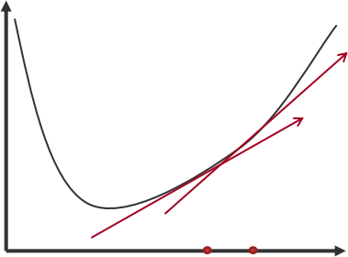
Gradient descent
We are trying to minimize
J(w)
General strategy for minimizing a function J(w)
• Start with an initial guess for w, say w0
• Iterate till convergence:
– Compute the gradient of the gradient of J at wt
– Update wtto get wt+1 by taking a step in the opposite direction of the gradient
w
w1
w0
Intuition: The gradient is the direction of steepest increase in the function. To get to the minimum, go in the opposite direction
23

Slide 70
FREQUENTIST STATISTICS
The Famous Coin Flip Experiment
When we flip a coin, there are two possible outcomes - heads or tails. Of course, there is a third rare possibility where the coin balances on its edge without falling onto either side, which we assume is not a possible outcome of the coin flip for our discussion. We conduct a series of coin flips and record our observations i.e. the number of the heads (or tails) observed for a certain number of coin flips. In this experiment, we are trying to determine the fairness of the coin, using the number of heads (or tails) that we observe.

Slide 71
FREQUENTIST STATISTICS
We have conducted a sufficient number of coin flip trials, we can determine the frequency or the probability of observing the heads (or tails).
If we observed heads and tails with equal frequencies or the probability of observing heads (or tails) is 0.5
Let's denote p as the probability of observing the heads.
Testing whether a hypothesis is true or false by calculating the probability of an event in a prolonged experiment is known as frequentist statistics.
As such, determining the fairness of a coin by using the probability of observing the heads is an example of frequentist statistics (or frequentist approach).

Slide 72
FREQUENTIST STATISTICS
When we flip the coin 10 times, we observe the heads 6 times. Therefore, the p is 0.6 (where, p is the number of heads observed over the number of total coin flips).
According to frequencies statistics, the coin is a biased coin — which opposes our assumption of a fair coin.
If you extends this experiment to 100 trails using the same coin. Then you observes heads 55 times, which results in a different p with 0.55.
This observation raises several questions:
How confident are we of p being 0.6?
How confident are of p being 0.55?
Which of these values is the accurate estimation of p?
Will p continue to change when we further increase the number of coin flip trails?

Slide 73
FREQUENTIST STATISTICS
Number of coin flips | Number of heads | Probability of observing heads
10 | 6 | 0.6
50 | 29 | 0.58
100 | 55 | 0.55
200 | 94 | 0.47
500 | 245 | 0.49
Table: Represents some of the possible outcomes of a hypothetical coin flip experiment when we are increasing the number of trials

Slide 74
FREQUENTIST STATISTICS
We can understand the importance of such a confident measure by studying the following cases:
An experiment with an infinite number of trials guarantees p with absolute accuracy (100% confidence). Yet, it is not practical to conduct an experiment with an infinite number of trials and we should stop the experiment after a sufficiently large number of trials. However, deciding the value of this sufficient number of trials is a challenge when using frequentist statistics.
If we can determine the confidence of the estimated $p$ value or the inferred conclusion, in a situation where the number of trials are limited, this will allow us to decide whether to accept the conclusion or to extend the experiment with more trials until it achieves sufficient confidence.

Slide 75
TERMINOLOGIES USED IN BAYESIAN
Random variable (Stochastic variable) - In statistics, the random variable is a variable whose possible values are a result of a random event. Therefore, each possible value of a random variable has some probability attached to it to represent the likelihood of those values.
Probability distribution - The function that defines the probability of different outcomes/values of a random variable. The continuous probability distributions are described using probability density functions whereas discrete probability distributions can be represented using probability mass functions.
Conditional probability - This is a measure of probability P(A|B) of an event A given that another event B has occurred.
Joint probability distribution -Joint probability is the probability of two events happening together. The two events are usually designated event A and event B. i.e P(A∩B)

Slide 76
INTRODUCTION TO BAYESIAN LEARNING
Suppose that you are allowed to flip the coin 10 times in order to determine the fairness of the coin.
Observations from the experiment will fall under one of the following cases:
Case 1: observing 5 heads and 5 tails.
Case 2: observing h heads and 10-h tails.
If case 2 is observed you can either:
Neglect your prior beliefs since now you have new data, decide the probability of observing heads is h/10 by solely depending on recent observations.
Adjust your belief accordingly to the value of h that you have just observed, and decide the probability of observing heads using your recent observations.

Slide 77
INTRODUCTION TOBAYESIAN LEARNING
BAYSEIAN LEARNING: It is this thinking model which uses the most recent observations together with our beliefs or inclination for critical thinking that is known as Bayesian thinking.
INCREMENTAL LEARNING: It is a learning ,where you update your knowledge incrementally with new evidence.

Slide 78
BAYESIAN LEARNING
Bayesian machine learning is a particular set of approaches to probabilistic machine learning.
Bayesian learning treats model parameters as random variables — in Bayesian learning, parameter estimation amounts to computing post.
Bayesian probability basically talks about the interpretation of “partial beliefs”.
Bayesian Estimation calculates the validity of the proposition.
Validity of the Proposition depends on two things:
Prior Estimate.
New Relevant evidence.

Slide 79
NAÏVE BAYES CLASSIFIER ALGORITHM
Naïve Bayes algorithm is a supervised learning algorithm, which is based on Bayes theorem and used for solving classification problems.
It is mainly used in text classification that includes a high-dimensional training dataset.
Naïve Bayes Classifier is one of the simple and most effective Classification algorithms which helps in building the fast machine learning models that can make quick predictions.
It is a probabilistic classifier, which means it predicts on the basis of the probability of an object.
Some popular examples of Naïve Bayes Algorithm are spam filtration, Sentimental analysis, and classifying articles.

Slide 80
WHY IT IS CALLED NAÏVE BAYES?
The Naïve Bayes algorithm is comprised of two words Naïve and Bayes, Which can be described as:
Naïve: It is called Naïve because it assumes that the occurrence of a certain feature is independent of the occurrence of other features. Such as if the fruit is identified on the bases of color, shape, and taste, then red, spherical, and sweet fruit is recognized as an apple. Hence each feature individually contributes to identify that it is an apple without depending on each other.
Bayes: It is called Bayes because it depends on the principle of Bayes' Theorem.

Slide 81

BAYES THEOREM
Bayes' theorem is also known as Bayes' Rule or Bayes' law, which is used to determine the probability of a hypothesis with prior knowledge. It depends on the conditional probability.
The formula for Bayes' theorem is given as:
Where,
P(A|B) is Posterior probability: Probability of hypothesis A on the observed event B.
P(B|A) is Likelihood probability: Probability of the evidence given that the probability of a hypothesis is true.
P(A) is Prior Probability: Probability of hypothesis before observing the evidence.
P(B) is Marginal Probability: Probability of Evidence.

Slide 82
EXAMPLE
Suppose we have a dataset of weather conditions and corresponding target variable "Play". So using this dataset we need to decide that whether we should play or not on a particular day according to the weather conditions. So to solve this problem, we need to follow the below steps:
Convert the given dataset into frequency tables.
Generate Likelihood table by finding the probabilities of given features.
Now, use Bayes theorem to calculate the posterior probability.
Problem: If the weather is sunny, then the Player should play or not?

Slide 83
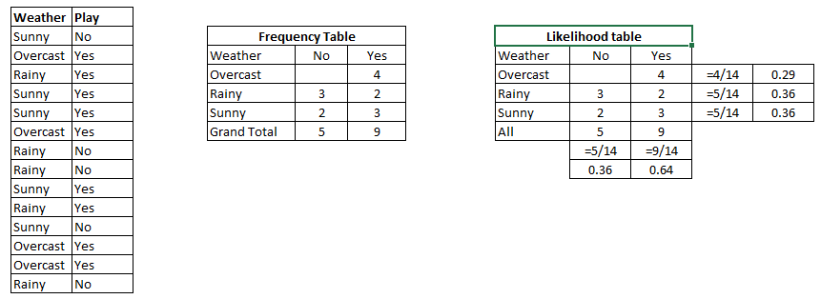
EXAMPLE
Solution: To solve this, first consider the below dataset:

Slide 84
EXAMPLE
We can solve it using above discussed method of posterior probability.
P(Yes | Sunny) = P( Sunny | Yes) * P(Yes) / P (Sunny)
Here we have P (Sunny |Yes) = 3/9 = 0.33, P(Sunny) = 5/14 = 0.36, P( Yes)= 9/14 = 0.64
Now, P (Yes | Sunny) = 0.33 * 0.64 / 0.36 = 0.60, which has higher probability.
Thus, A player can play on a sunny day.

Slide 85
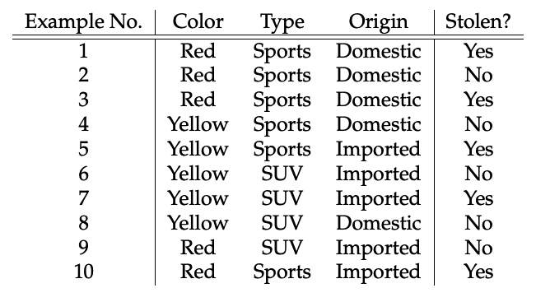
EXAMPLE
Consider the car theft problem with attributes Color, Type, Origin, and the target, Stolen can be either Yes or No.

Slide 86
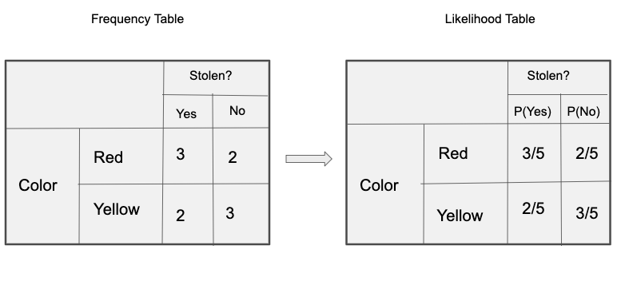
EXAMPLE

Slide 87
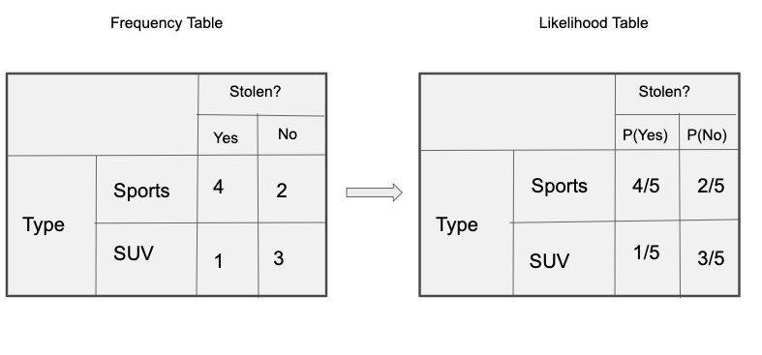
EXAMPLE

Slide 88
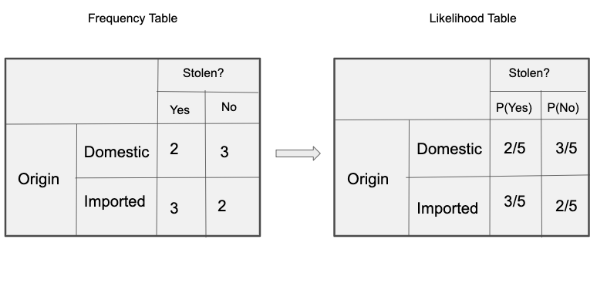
EXAMPLE

Slide 89


EXAMPLE
So in our example, we have 3 predictors X.
As per the equations discussed above, we can calculate the posterior probability P(Yes | X) as :

Slide 90

EXAMPLE
and, P(No | X):
Since 0.144 > 0.048, Which means given the features RED SUV and Domestic, our example gets classified as ’NO’ the car is not stolen.

Slide 91
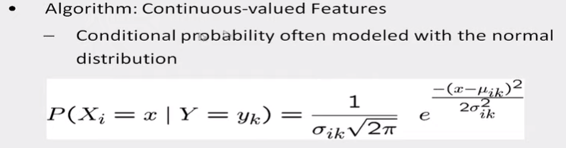
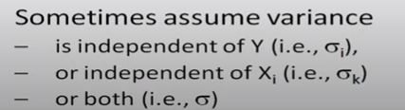
Naïve Bayes for continuous valued features
A Gaussian distribution is usually chosen to represent the class-conditional probability for continuous attributes.

Slide 92
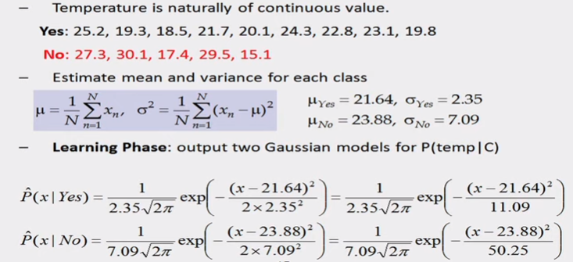
Example

Slide 93
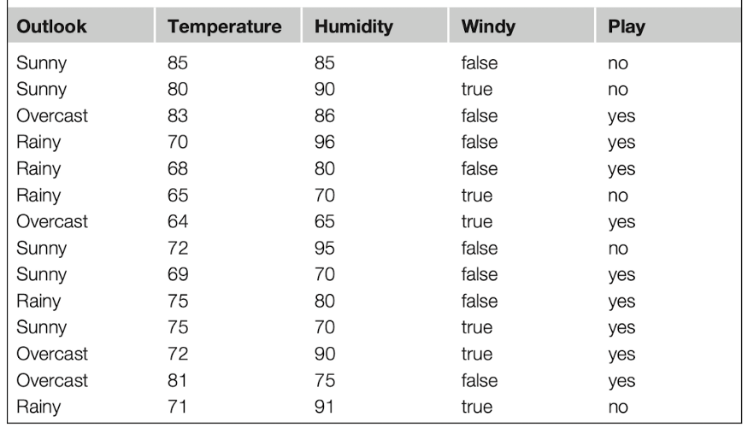
Example

Slide 94
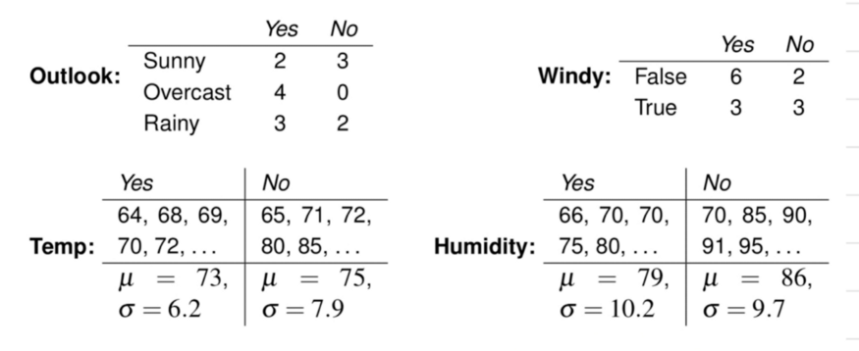
Example

Slide 95
Solution
likelihood for play=yes
P(x/yes) * P(yes) = P(sunny/yes) * P(Temperature=66/yes) * P(Humidity=90/yes) * P(True/yes) * P(yes)
likelihood for play=no
P(x/no) * P(no) = P(sunny/no) * P(Temperature=66/no) * P(Humidity=90/no) * P(True/no) * P(no)
P(sunny/yes) = 2/9
P(Temperature=66/yes) = 0.034
P(Humidity=90/yes) = 0.0221
P(True/yes) = 3/9
and
P(sunny/no) = 3/5
P(Temperature=66/no) = 0.0279
P(Humidity=90/no) = 0.0381
P(True/no) = 3/5
P(x/yes) * P(yes) = (2/9) * 0.034 * 0.0221 * (3/9) * (9/14) = 0.000036
P(x/no) * P(no) = (3/5) * 0.0279* 0.0381* (3/5) * (5/14) = 0.008137
0.008137 > 0.000036
Classification — NO

Slide 96
PROS AND CONS OF NAÏVE’S BAYES
Pros:
It is easy and fast to predict class of test data set. It also perform well in multi class prediction
When assumption of independence holds, a Naive Bayes classifier performs better compare to other models like logistic regression and you need less training data.
It perform well in case of categorical input variables compared to numerical variable(s). For numerical variable, normal distribution is assumed (bell curve, which is a strong assumption).

Slide 97
PROS AND CONS OF NAÏVE’S BAYES
Cons:
If categorical variable has a category (in test data set), which was not observed in training data set, then model will assign a 0 (zero) probability and will be unable to make a prediction. This is often known as “Zero Frequency”.

Slide 98
BAYESIAN BELIEF NETWORK
A Bayesian network is a probabilistic graphical model which represents a set of variables and their conditional dependencies using a directed acyclic graph.
It is also called a Bayes network, belief network, decision network, or Bayesian model.
Bayesian networks are probabilistic, because these networks are built from a probability distribution, and also use probability theory for prediction and anomaly detection.
Bayesian Network can be used for building models from data and experts opinions, and it consists of two parts:
Directed Acyclic Graph
Table of conditional probabilities.

Slide 99
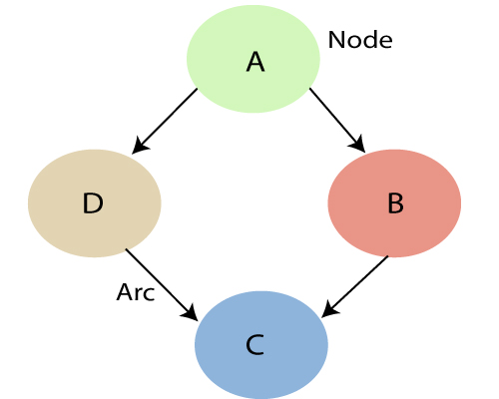
BAYESIAN BELIEF NETWORK(EXAMPLE)
A Bayesian network graph is made up of nodes and Arcs (directed links), where:

Slide 100
BAYESIAN BELIEF NETWORK(EXAMPLE)
Each node corresponds to the random variables, and a variable can be continuous or discrete.
Arc or directed arrows represent the causal relationship or conditional probabilities between random variables.
These directed links or arrows connect the pair of nodes in the graph.
These links represent that one node directly influence the other node, and if there is no directed link that means that nodes are independent with each other
In the above diagram, A, B, C, and D are random variables represented by the nodes of the network graph.
If we are considering node B, which is connected with node A by a directed arrow, then node A is called the parent of Node B.
Node C is independent of node A.

Slide 101
EXPLAINATION
Example: Harry installed a new burglar alarm at his home to detect burglary. The alarm reliably responds at detecting a burglary but also responds for minor earthquakes. Harry has two neighbors David and Sophia, who have taken a responsibility to inform Harry at work when they hear the alarm. David always calls Harry when he hears the alarm, but sometimes he got confused with the phone ringing and calls at that time too. On the other hand, Sophia likes to listen to high music, so sometimes she misses to hear the alarm. Here we would like to compute the probability of Burglary Alarm.
Problem: Calculate the probability that alarm has sounded, but there is neither a burglary, nor an earthquake occurred, and David and Sophia both called the Harry.

Slide 102
EXPLAINATION
The Bayesian network for the above problem is given below. The network structure is showing that burglary and earthquake is the parent node of the alarm and directly affecting the probability of alarm's going off, but David and Sophia's calls depend on alarm probability.
The network is representing that our assumptions do not directly perceive the burglary and also do not notice the minor earthquake, and they also not confer before calling.
The conditional distributions for each node are given as conditional probabilities table or CPT.
Each row in the CPT must be sum to 1 because all the entries in the table represent an exhaustive set of cases for the variable.
In CPT, a boolean variable with k boolean parents contains 2^{K} probabilities. Hence, if there are two parents, then CPT will contain 4 probability value

Slide 103
EXPLAINATION
List of all events occurring in this network:
Burglary (B)
Earthquake(E)
Alarm(A)
David Calls(D)
Sophia calls(S)

Slide 104
EXPLAINATION
We can write the events of problem statement in the form of probability: P[D, S, A, B, E], can rewrite the above probability statement using joint probability distribution:
P[D, S, A, B, E]= P[D | S, A, B, E]. P[S, A, B, E]
=P[D | S, A, B, E]. P[S | A, B, E]. P[A, B, E]
= P [D| A]. P [ S| A, B, E]. P[ A, B, E]
= P[D | A]. P[ S | A]. P[A| B, E]. P[B, E]
= P[D | A ]. P[S | A]. P[A| B, E]. P[B |E]. P[E]

Slide 105
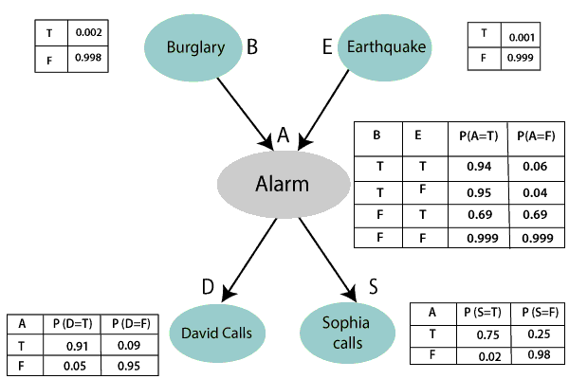
EXPLAINATION

Slide 106
EXPLAINATION
Let's take the observed probability for the Burglary and earthquake component:
P(B= True) = 0.002, which is the probability of burglary.
P(B= False)= 0.998, which is the probability of no burglary.
P(E= True)= 0.001, which is the probability of a minor earthquake
P(E= False)= 0.999, Which is the probability that an earthquake not occurred.

Slide 107
EXPLAINATION
Conditional probability table for Alarm A:
The Conditional probability of Alarm A depends on Burglar and earthquake:
B | E | P(A= True) | P(A= False)
True | True | 0.94 | 0.06
True | False | 0.95 | 0.04
False | True | 0.31 | 0.69
False | False | 0.001 | 0.999

Slide 108
EXPLAINATION
Conditional probability table for David Calls:
The Conditional probability of David that he will call depends on the probability of Alarm.
A | P(D= True) | P(D= False)
True | 0.91 | 0.09
False | 0.05 | 0.95
Conditional probability table for Sophia Calls:
The Conditional probability of Sophia that she calls is depending on its Parent Node "Alarm."
A | P(S= True) | P(S= False)
True | 0.75 | 0.25
False | 0.02 | 0.98

Slide 109
EXPLAINATION
From the formula of joint distribution, we can write the problem statement in the form of probability distribution:
P(S, D, A, ¬B, ¬E) = P (S|A) *P (D|A)*P (A|¬B ^ ¬E) *P (¬B) *P (¬E).
= 0.75* 0.91* 0.001* 0.998*0.999
= 0.00068045.
Hence, a Bayesian network can answer any query about the domain by using Joint distribution.

Slide 110
INTRODUCTION TO EM
Expectation-Maximization algorithm can be used for the latent variables (variables that are not directly observable and are actually inferred from the values of the other observed variables) too in order to predict their values with the condition that the general form of probability distribution governing those latent variables is known to us.
This algorithm is actually at the base of many unsupervised clustering algorithms in the field of machine learning.
The essence of Expectation-Maximization algorithm is to use the available observed data of the dataset to estimate the missing data and then using that data to update the values of the parameters.

Slide 111
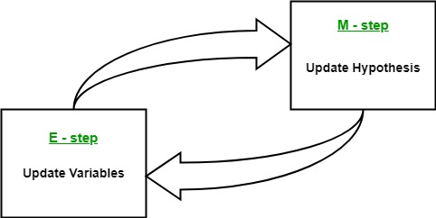
EM ALGORITHM
Given a set of incomplete data, consider a set of starting parameters.
Expectation step (E – step): Using the observed available data of the dataset, estimate (guess) the values of the missing data.
Maximization step (M – step): Complete data generated after the expectation (E) step is used in order to update the parameters.
Repeat step 2 and step 3 until convergence.

Slide 112
EM ALGORITHM
Let us understand the EM algorithm in detail.
Initially, a set of initial values of the parameters are considered. A set of incomplete observed data is given to the system with the assumption that the observed data comes from a specific model.
The next step is known as “Expectation” – step or E-step. In this step, we use the observed data in order to estimate or guess the values of the missing or incomplete data. It is basically used to update the variables.
The next step is known as “Maximization”-step or M-step. In this step, we use the complete data generated in the preceding “Expectation” – step in order to update the values of the parameters. It is basically used to update the hypothesis.
Now, in the fourth step, it is checked whether the values are converging or not, if yes, then stop otherwise repeat step-2 and step-3 i.e. “Expectation” – step and “Maximization” – step until the convergence occurs.

Slide 113
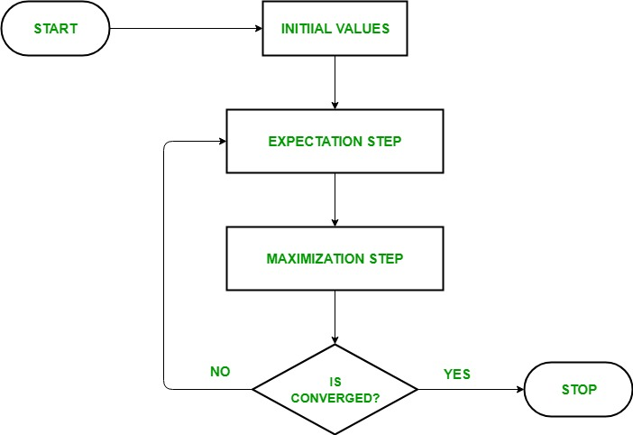
FLOW CHART OF EM ALGORITHM

Slide 114
EXAMPLE
Let C1 and C2 be two coins
ᶿ1 be the probability of getting head with C1
ᶿ2 be the probability of getting head with C2
Problem: To Find value of ᶿ1 and ᶿ2 by tossing C1 and C2 multiple times.

Slide 115
EXAMPLE
Toss for 5 times choosing any of the coins randomly.
Each selected coin has to toss for 10 times.
B | H | T | T | T | H | H | T | H | T | H
A | H | H | H | H | T | H | H | H | H | H
A | H | T | H | H | H | H | H | T | H | H
B | H | T | H | T | T | T | H | H | T | T
A | T | H | H | H | T | H | H | H | T | H

Slide 116
EXAMPLE
ᶿ1= Number of heads with C1
Total no. of flips using C1
ᶿ2= Number of heads with C2
Total no. of flips using C2

Slide 117
EXAMPLE
If we know the coin labels , the probability will be:
COIN A | COIN B
 | 5 H, 5T
9H,1T
8H,2T
 | 4H,6T
7H,3T
ᶿ1= 24/(24+6)= 0.8
ᶿ2= 9/(9+11)=0.45

Slide 118
EXAMPLE
If we don’t know the identity of coin labels , then we will assume or estimate the probabilities:
ᶿ1=0.6
ᶿ2=0.5
We have to use the binomial distribution to find likelihood
L(c) = ᶿ^k(1-ᶿ)^n-k

Slide 119
EXAMPLE
Likelihood for first coin flip
L(A) = 0.6^5(1-0.6)^10-5= 0.0007963
L(B)=0.5^5(1-0.5)^10-5=0.0009766
P(A)=L(A)/L(A)+L(B)
=0.0007963/(0.0007963+0.0009766)
=0.45
P(B)= L(B)/L(A)+L(B)
=0.0009766/(0.0007963+0.0009766)
=0.55

Slide 120
EXAMPLE
In similar fashion find the probability of all coins with all flips. It will be as follows
L(H): Likely no. of heads ; L(T): Likely no. of tails
 |  |  |  |  |  |  |  |  |  |  | P(A) | P(B) | L(H)1 | L(T)1 | L(H)2 | L(T)2
B | H | T | T | T | H | T | H | T | H | H | 0.45 | 0.55 | 2.2 | 2.2 | 2.8 | 2.8
A | H | H | H | H | T | H | H | H | H | T | 0.80 | 0.20 | 7.2 | 0.8 | 1.8 | 0.2
A | H | T | H | H | H | H | T | H | H | H | 0.73 | 0.27 | 5.9 | 1.5 | 2.1 | 0.5
B | H | T | H | T | T | H | H | T | T | H | 0.35 | 0.65 | 1.4 | 2.1 | 2.6 | 3.9
A | T | H | H | H | H | H | H | T | H | T | 0.65 | 0.35 | 4.5 | 1.9 | 2.5 | 1.1

Slide 121
EXAMPLE
For Coin A: For Coin B:
∑L(H)=21.3 ∑L(H)=11.7
∑L(T)=8.6 ∑L(T)=8.4
ᶿ1=21.3/(21.3+8.6) ᶿ2=11.7/(11.7+8.4)
= 0.71 =0.58
These values of ᶿ1 and ᶿ2 will be sent to next iteration.
The Process will continue until you get the stable values of ᶿ1 and ᶿ2
After 10 iterations
ᶿ1 =0.80 and ᶿ2 =0.52

Slide 122
USAGE OF EM ALGORITHM
It can be used to fill the missing data in a sample.
It can be used as the basis of unsupervised learning of clusters.
It can be used for the purpose of estimating the parameters of Hidden Markov Model (HMM).
It can be used for discovering the values of latent variables.

Slide 123
ADVANTAGES OF EM ALGORITHM
It is always guaranteed that likelihood will increase with each iteration.
The E-step and M-step are often pretty easy for many problems in terms of implementation.
Solutions to the M-steps often exist in the closed form

Slide 124
DISADVANTAGES OF EM ALGORITHM
It has slow convergence.
It makes convergence to the local optima only.
It requires both the probabilities, forward and backward (numerical optimization requires only forward probability).

Slide 125
SUPPORT VECTOR MACHINES
Support Vector Machine or SVM is one of the most popular Supervised Learning algorithms, which is used for Classification as well as Regression problems. However, primarily, it is used for Classification problems in Machine Learning. The goal of the SVM algorithm is to create the best line or decision boundary that can segregate n-dimensional space into classes so that we can easily put the new data point in the correct category in the future. This best decision boundary is called a hyperplane. SVM chooses the extreme points/vectors that help in creating the hyperplane. These extreme cases are called as support vectors, and hence algorithm is termed as Support Vector Machine. SVM algorithm can be used for Face detection, image classification, text categorization, etc.

Slide 126

SUPPORT VECTOR MACHINES
Consider the below diagram in which there are two different categories that are classified using a decision boundary or hyperplane:

Slide 127
TYPES OF SVM
SVM can be of two types:
Linear SVM: Linear SVM is used for linearly separable data, which means if a dataset can be classified into two classes by using a single straight line, then such data is termed as linearly separable data, and classifier is used called as Linear SVM classifier.
Non-linear SVM: Non-Linear SVM is used for non-linearly separated data, which means if a dataset cannot be classified by using a straight line, then such data is termed as non-linear data and classifier used is called as Non-linear SVM classifier.

Slide 128
CONFIDENCE INTERVALS
Hyperplane:
There can be multiple lines/decision boundaries to segregate the classes in n-dimensional space, but we need to find out the best decision boundary that helps to classify the data points. This best boundary is known as the hyperplane of SVM.
The dimensions of the hyperplane depend on the features present in the dataset, which means if there are 2 features (as shown in image), then hyperplane will be a straight line. And if there are 3 features, then hyperplane will be a 2-dimension plane.
We always create a hyperplane that has a maximum margin, which means the maximum distance between the data points.
Support Vectors:
The data points or vectors that are the closest to the hyperplane and which affect the position of the hyperplane are termed as Support Vector. Since these vectors support the hyperplane, hence called a Support vector.

Slide 129
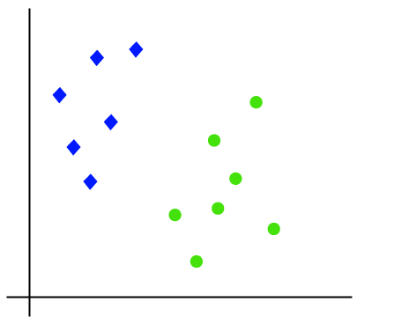
HOW DOES SVM WORKS?
Linear SVM:
The working of the SVM algorithm can be understood by using an example. Suppose we have a dataset that has two tags (green and blue), and the dataset has two features x1 and x2. We want a classifier that can classify the pair(x1, x2) of coordinates in either green or blue.
Consider the below image:

Slide 130
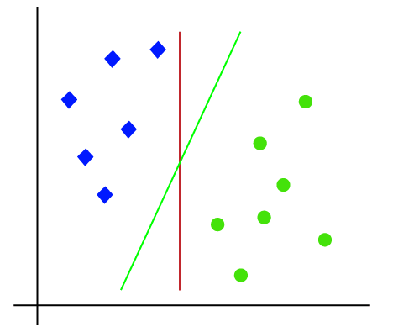
HOW DOES SVM WORKS?
So as it is 2-d space so by just using a straight line, we can easily separate these two classes. But there can be multiple lines that can separate these classes. Consider the below image:

Slide 131
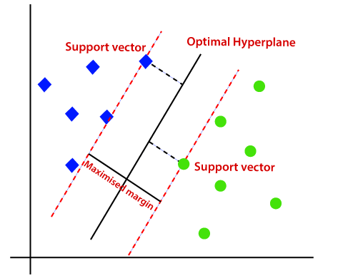
HOW DOES SVM WORKS?
Hence, the SVM algorithm helps to find the best line or decision boundary; this best boundary or region is called as a hyperplane.
SVM algorithm finds the closest point of the lines from both the classes.
These points are called support vectors.
The distance between the vectors and the hyperplane is called as margin. And the goal of SVM is to maximize this margin.
The hyperplane with maximum margin is called the optimal hyperplane.

Slide 132

HOW DOES SVM WORKS?
2. Non-Linear SVM:
If data is linearly arranged, then we can separate it by using a straight line, but for non-linear data, we cannot draw a single straight line. Consider the below image:

Slide 133


HOW DOES SVM WORKS?
So to separate these data points, we need to add one more dimension. For linear data, we have used two dimensions x and y, so for non-linear data, we will add a third dimension z. It can be calculated as:
Z=$χ^{2}+γ^{2}$
By adding the third dimension, the sample space will become as below image:

Slide 134

HOW DOES SVM WORKS?
So now, SVM will divide the datasets into classes in the following way. Consider the below image:

Slide 135
SVM KERNEL FUNCTIONS
SVM algorithms use a set of mathematical functions that are defined as the kernel.
The function of kernel is to take data as input and transform it into the required form.
Different SVM algorithms use different types of kernel functions. These functions can be different types. For example linear, nonlinear, polynomial, radial basis function (RBF), and sigmoid.
The most used type of kernel function is RBF. Because it has localized and finite response along the entire x-axis. The kernel functions return the inner product between two points in a suitable feature space.
Thus by defining a notion of similarity, with little computational cost even in very high-dimensional spaces.

Slide 136

TYPES OF KERNELS
1. Polynomial kernel
It is popular in image processing. Equation is:
where d is the degree of the polynomial.
2. Gaussian kernel
It is a general-purpose kernel; used when there is no prior knowledge about the data. Equation is:

Slide 137
TYPES OF KERNELS
3. Gaussian radial basis function (RBF)
It is a general-purpose kernel; used when there is no prior knowledge about the data. Equation is:
4. Hyperbolic tangent kernel
We can use it in neural networks. Equation is:
, for some (not every) k>0 and c<0.

Slide 138
TYPES OF KERNELS
5. Sigmoid kernel
We can use it as the proxy for neural networks.
Equation is:

Slide 139
PROPERTIES OF SVM
SVM works relatively well when there is a clear margin of separation between classes.
SVM is more effective in high dimensional spaces.
SVM is effective in cases where the number of dimensions is greater than the number of samples.
SVM is relatively memory efficient

Slide 140
ISSUES IN SVM
SVM algorithm is not suitable for large data sets.
SVM does not perform very well when the data set has more noise i.e. target classes are overlapping.
In cases where the number of features for each data point exceeds the number of training data samples, the SVM will underperform.
As the support vector classifier works by putting data points, above and below the classifying hyperplane there is no probabilistic explanation for the classification.

Slide 141
Faculty Video Links, Youtube & NPTEL Video Links and Online Courses Details
Youtube/Other Video Links:
1. Machine Learning by Prof. Balaraman ravindran, Department of computer science and engineering,IIT Madras (SWAYAM/NPTEL)
https://www.youtube.com/watch?v=fC7V8QsPBec&feature=youtu.be
2. Machine Learning by Prof. Sudeshna Sarkar, Department of computer science and engineering,IIT Kharagpur (NPTEL)
https://www.youtube.com/watch?v=EWmCkVfPnJ8&list=PLlGkyYYWOSOsGU-XARWdIFsRAJQkyBrVj&index=2
3. Machine learning UPGRAD course by IIIT,Bangalore
https://www.upgrad.com/machine-learning-ai-pgd-iiitb/

Slide 142
Daily Quiz
1. Which of the following is true about Naive Bayes ?
Assumes that all the features in a dataset are equally important
Assumes that all the features in a dataset are independent
Both A and B
None of the above
2. Where does the bayes rule can be used? a) Solving queries b) Increasing complexity c) Decreasing complexity d) Answering probabilistic query

Slide 143
Daily Quiz
3. What does the bayesian network provides? a) Complete description of the domain b) Partial description of the domain c) Complete description of the problem d) None of the mentioned
4. How the compactness of the Bayesian network can be described? a) Locally structured b) Fully structured c) Partial structure d) All of the mentioned

Slide 144
Daily Quiz
5. The effectiveness of an SVM depends upon:
A) Selection of Kernel B) Kernel Parameters C) Soft Margin Parameter C D) All of the above
6. Support vectors are the data points that lie closest to the decision surface.
TRUE
B) FALSE
7. The SVM’s are less effective when:
A) The data is linearly separable B) The data is clean and ready to use C) The data is noisy and contains overlapping points

Slide 145
Daily Quiz
8. SVM is a __________________ Learning Algorithm a) Supervised
b) Unsupervised
c)Both
D None
9. SVM is termed as _____________ classifier
Maximum margin
Minimum Margin
10. The training examples closest to the separating hyperplane are called as _______
Training vectors
Test vectors
Support Vectors

Slide 146
Weekly Assignment
1. Explain the concept of Bayes theorem with an example.
2. Explain Bayesian belief network and conditional independence with example.
3. What are Bayesian Belief nets? Where are they used?
4. Explain Brute force MAP hypothesis learner? What is minimum description length principle.

Slide 147
Weekly Assignment
5. Explain Brute force Bayes Concept Learning
6. Explain the concept of EM Algorithm.
7. What is conditional Independence?
8. Explain Naïve Bayes Classifier with an Example.
9. Describe the concept of MDL.
10. Define
(i) Prior Probability
(ii) Conditional Probability
(iii) Posterior Probability

Slide 148
MCQ s
1. _____ is the mathematical likelihood that something will occur.
Classification.
Probability.
Naive Bayes Classifier.
None of the other answers are correct.
2. The Naive Bayes Classifier is a _____ in probability.
Technique.
Process.
Classification.
None of these answers are correct.

Slide 149
MCQ s
3) If you remove the following any one red points from the data. Does the decision boundary will change?
A) Yes B) No
4) If you remove the non-red circled points from the data, the decision boundary will change?
A) True B) False
5) What do you mean by generalization error in terms of the SVM?
A) How far the hyperplane is from the support vectors
B) How accurately the SVM can predict outcomes for unseen data
C) The threshold amount of error in an SVM

Slide 150
Old Question Papers

Slide 151
Old Question Papers

Slide 152
Old Question Papers

Slide 153


Sessional Question Papers

Slide 154

Sessional Question Papers

Slide 155

Sessional Question Papers

Slide 156
Expected Questions for University Exam
Explain the various types of issues in machine learning.
Define the learning classifiers.
Differentiated between Bayesian Learning and Instance based Learning.
Discuss various Artificial Neural Network Architectures.
Explain back propagation algorithm and derive expressions for weight update relations.

Slide 157
Glossary Questions
1. Choose correct option
i. Selection of Kernel and parameter ii. Classification iii. Overfitting iv) noisy
a. Naive Bayes are a collection------------------of algorithms
b. The effectiveness of an SVM depends upon---
c. The SVM’s are less effective if data is …
d. If I am using all features of my dataset and I achieve 100% accuracy on my training set, but ~70% on validation set, what should I look out for….
2. Choose correct option
i. Gaussian kernel ii. supervised iii. Image Classification
real world applications of the SVM is …
We usually use feature normalization before using the ….in SVM
SVM is a ….Learning can be used for

Slide 158
Recap
Bayesian Belief Networks
• Combine prior knowledge with observed data
• Impact of prior knowledge (when correct!) is to lower the sample complexity
• Active research area:
1. Extend from boolean to real-valued variables
2. Parameterized distributions instead of tables
3. Extend to first-order instead of propositional systems
4. More effective inference methods

Slide 159
Summary
Bayesian Belief Networks
• Combine prior knowledge with observed data
• Impact of prior knowledge (when correct!) is to lower the sample complexity
• Active research area:
1. Extend from boolean to real-valued variables
2. Parameterized distributions instead of tables
3. Extend to first-order instead of propositional systems
4. More effective inference methods

Slide 160
References
Reference Books:
Introduction to Statistical Learning, Springer, 2013 By Gareth James, Daniela Witten, Trevor Hastie, Robert Tibshirani.
Pattern Classification, 2nd Ed., John Wiley & Sons, 2001, Richard Duda, Peter Hart, David Stork.
Machine Learning, McGraw Hill International Edition, by Tom.M.Mitchell.
Introduction to Machine Learning, Eastern Economy Edition, Prentice Hall of India, 2005 By Ethern Alpaydin.
Pattern Recognition and Machine Learning. Berlin: Springer-Verlag., Bishop, C.

Slide 161
Thank You

